Slide 1
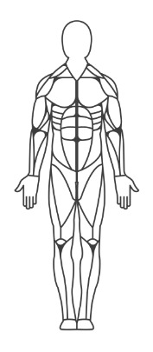
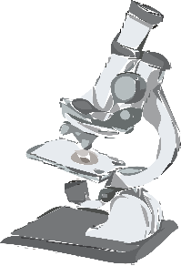
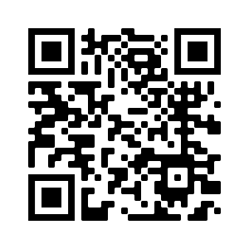
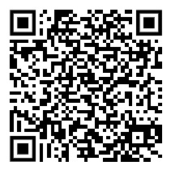
Human Anatomy & Physiology
- - - Course syllabus | 2023 - 2024 - - -
………………………………………………………………….………………………....
Course and Contact
Information
Instructor:
Jessica Briscoe
jbriscoe@tcjackets.net
229.225.5050 // Ext. 2713
Planning:
10:45 – 11:35
Teacher Website:
The human body is the only machine for which there are no spare parts.
Jeffrey eugenides
Success in anatomy & physiology is dependent upon several variables. These variables may include, but are not limited to, your participation, your enthusiasm, your commitment, and your diligence.
Success in this class depends on you taking
responsibility for preparing to be successful.
The following are a part of your responsibilities for A&P:
Always bring the necessary materials to class.
When you arrive to class, take your seat and begin the warm up when there is one to complete.
Be engaged while you are in class.
Read and/or listen to directions.
……………………………………………………………………………...……….……..
…………………………………………..
Assignments and grading
materials
These are items we will use on a daily basis in class:
3-ring binder with dividers
Pens / pencils
Colored pencils or markers
A wireless mouse is recommended but not required.
35%
Tests
25%
Labs & Activities
20%
Daily Work & Quizzes
…………………………………………………….
20%
Benchmark
Course Description & Standards
Human anatomy and physiology is designed to continue student investigations that began in grades K-8 and high school biology. It integrates the study of the structures and functions of the human body, however rather than focusing on distinct anatomical and physiological systems (respiratory, nervous, etc.) instruction will focus on the essential requirements for life. Areas of study include organization of the body; protection, support and movement; providing internal coordination and regulation; processing and transporting; and reproduction, growth and development. Case studies concerning diseases, disorders and ailments are also emphasized. Scan the QR code above for a link to the A&P standards.
…………………………………………………………..
……………………………………..
Rules & Expectations
Be respectful. Be responsible. Be safe.

Slide 2
Policies
- - - Course syllabus | 2023 – 2024 - - -
……………………………………………………………………………...……………..
Late/makeup work policy
The expectation is that you submit
all assignments on time.
If you are absent, it is your responsibility to follow proper procedures to ensure that you receive your work. You will have 3 days to turn in work completed during your absence and grades taken while you’re out may be marked as missing until turned in. You will have three days to make up any missing assignments or they will be considered late; he maximum possible score for late work is 70.
Discipline Policy
Respect yourself, your teacher, and your classmates and everything will be peachy. However, choosing to do otherwise will result in the following:
1st offense:
Warning / Student – Teacher Conference
2nd offense:
Detention and/or Parent Contact
3rd offense:
Referral
……………………………………………………………………………...……………..
Other policies
Cheating, copying, passing someone else’s work as your own or ANY other form of plagiarism is not allowed.
You will be assigned a number for class; you will be expected to put your number at the top of all assignments submitted. Papers without a number will be returned to a separate bin and not returned to the student.
Arrive on time. If you are late, you will receive a verbal warning. After that, you face detentions and referrals.
Textbooks will remain in the classroom and can be checked out if needed.
Essentials of Human Anatomy & Physiology (Replacement cost: $100)
All handbook rules also apply to our classroom.
The teacher reserves the right to make changes to the syllabus as needed.
technology
Students are not allowed to use or charge any electronic devices during class unless the device has been approved by the teacher for instructional purposes. See the handbook for consequences.
…………………………………….……………………………………………..
…………………………………………..
Course outline
Aug – Oct: Intro to Anatomy // Support & Motion
Oct – Jan: Control & Coordination // Transport
Jan – Feb: Absorption & Excretion // Protection
Feb – May: Reproduction // Review
I have read and understand this syllabus and its contents. I will honor and follow the rules, expectations, and procedures outlined above.
Student signature: ________________________________________________________
Parent signature: _________________________________________________________

